Slide 1
etl
Presented by: ugonma, Julia & chidima

Slide 2
Hotel reviews
Source: Kaggle & Datafiniti
Dataset: A list of 1,000 hotels & their online reviews

Slide 3
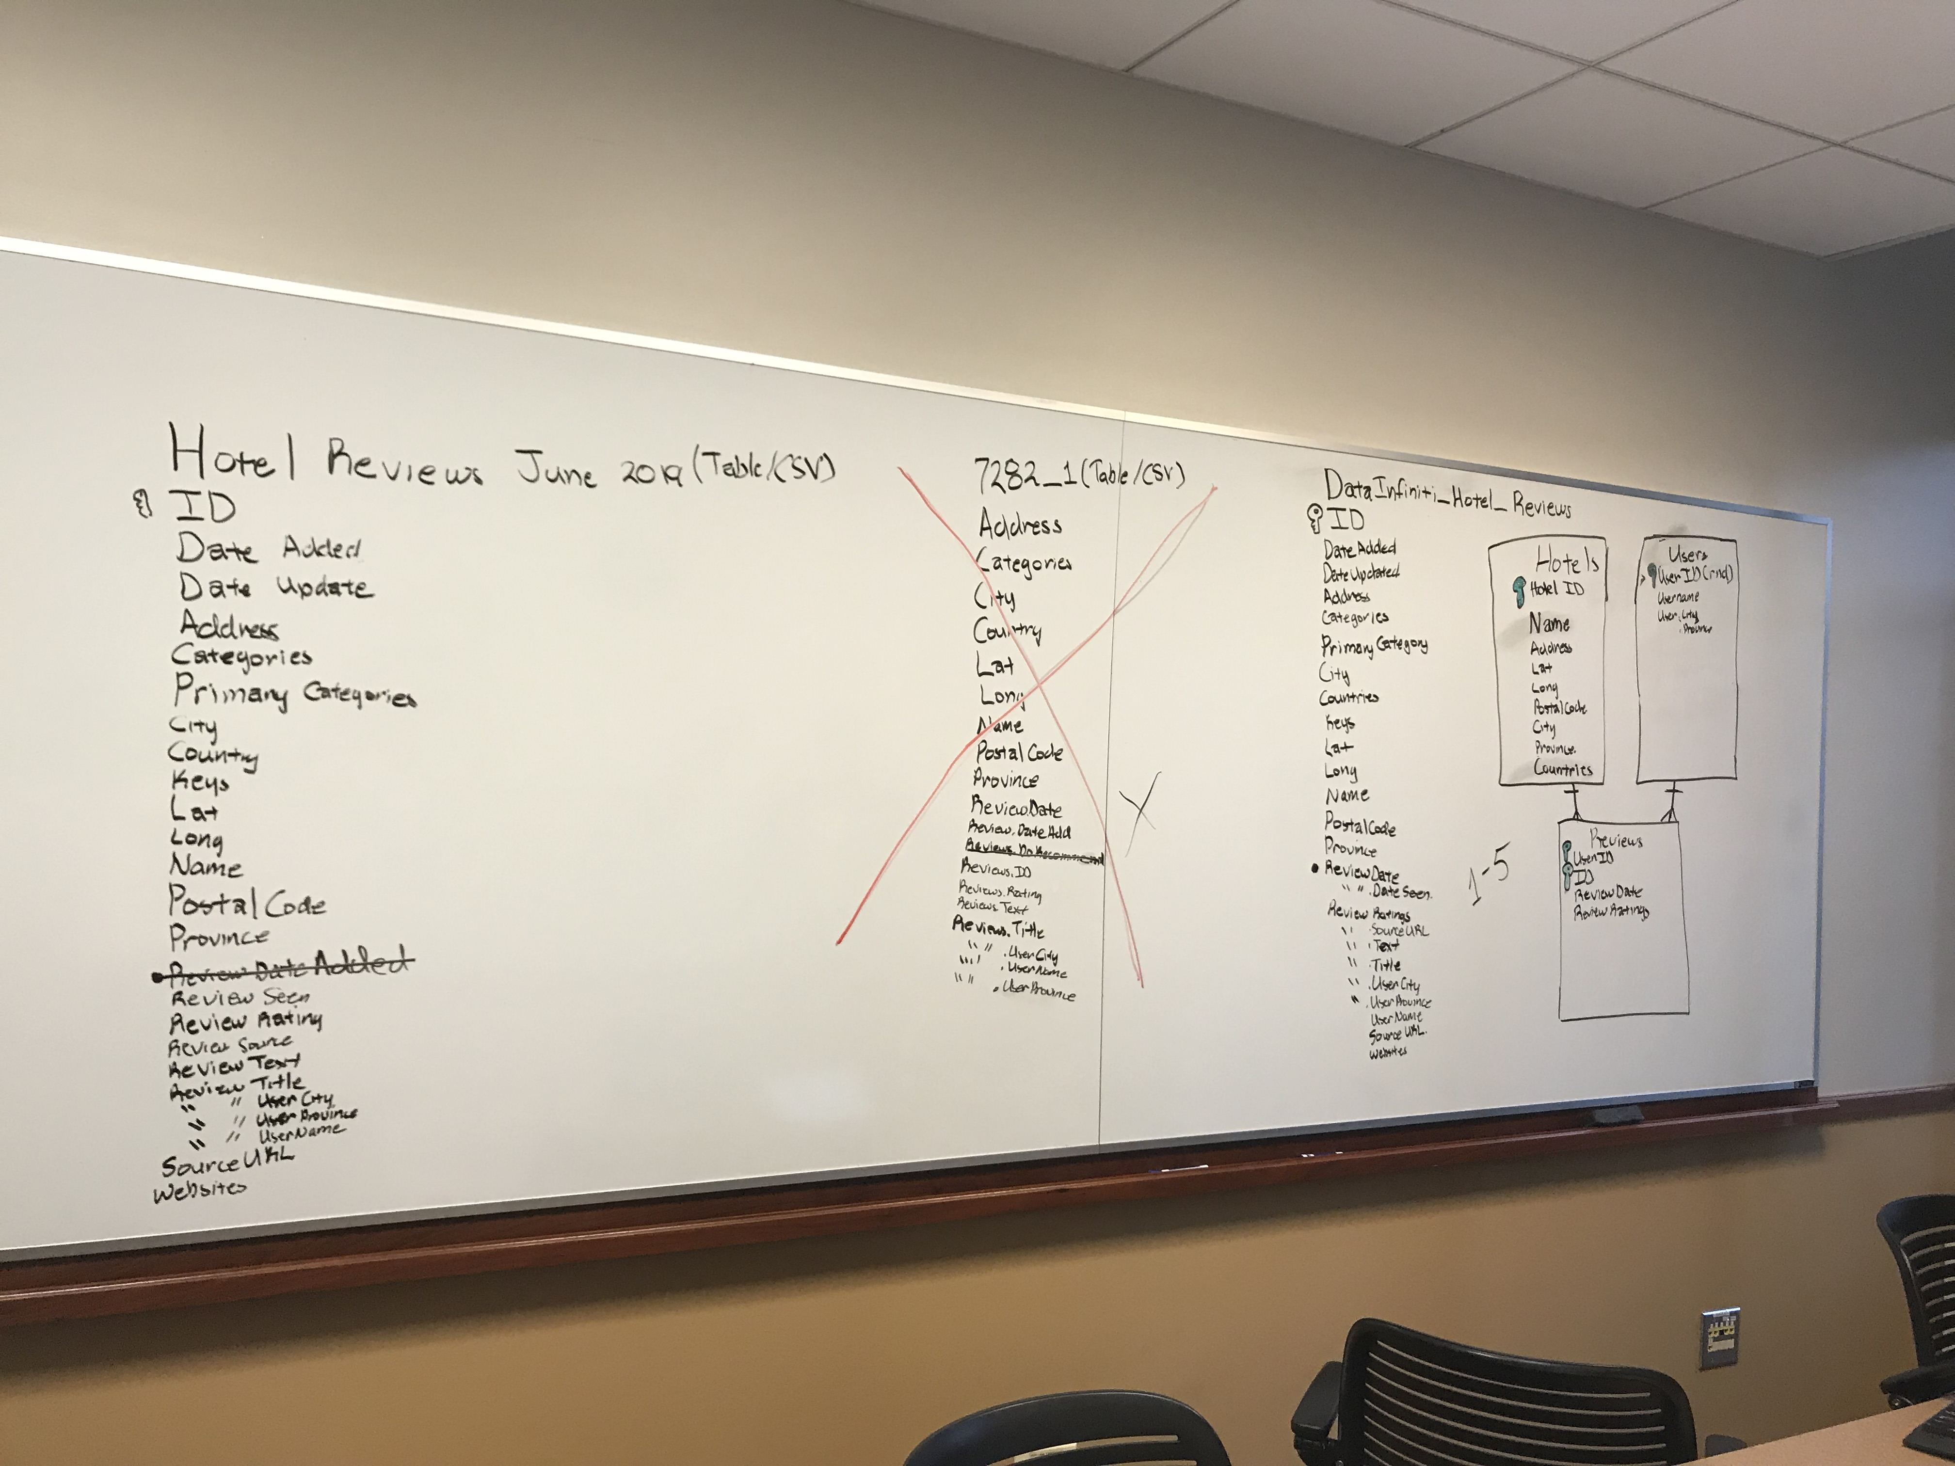
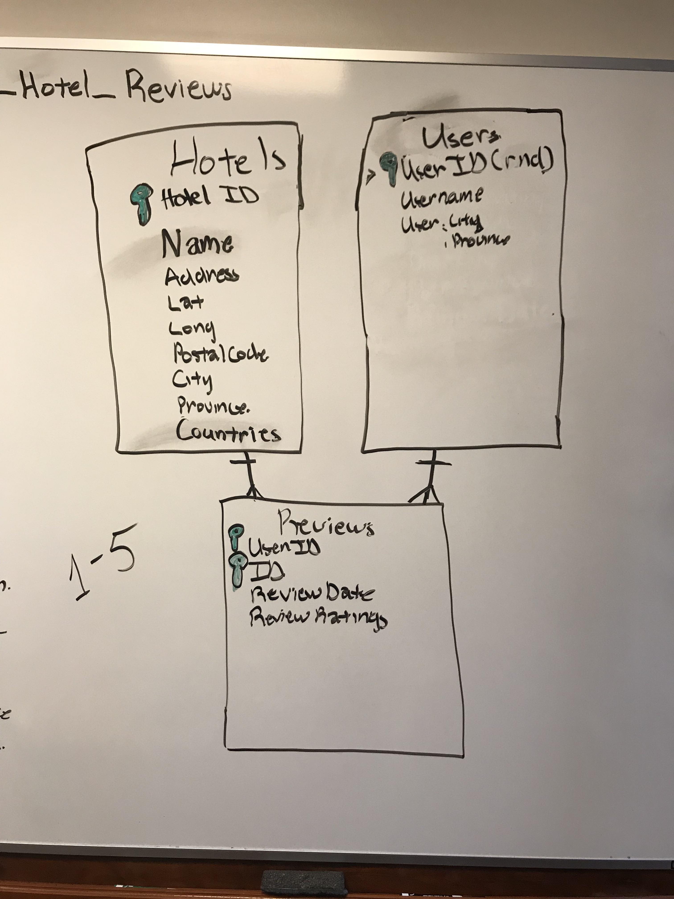
Data cleanup & analysis

Slide 4
Final report

Slide 5
bonus
Heat Map

Slide 6
Bonus us reviews heat map

